Slide 1

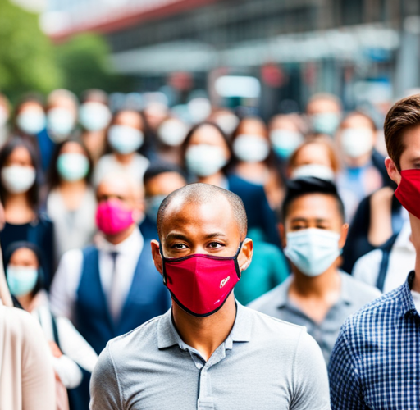
Face Mask Detection Using Convolutional Neural Networks (CNN)
Detecting face masks for public health and safety
Notes:
- Introduce the topic of face mask detection using CNNs

Slide 2
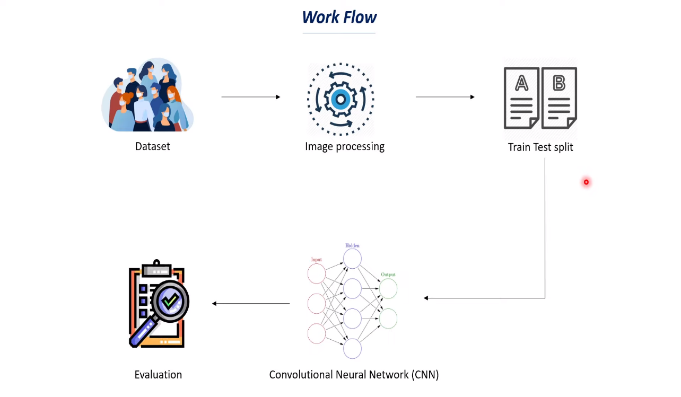
Approach
Convolutional Neural Networks (CNNs) are specifically designed for image classification tasks. They consist of convolutional layers, pooling layers, and fully connected layers. CNNs are effective in capturing complex patterns and relationships in data, making them well-suited for face mask detection.
Notes:
- Explain the approach to face mask detection using CNNs

Slide 3

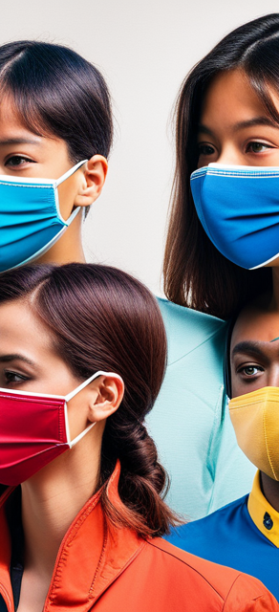
Model Architecture
The model architecture for face mask detection includes an input layer that accepts 128x128 RGB images. It consists of convolutional layers that extract features using filters and ReLU activation, pooling layers that downsample feature maps, a flatten layer that converts 2D feature maps to a 1D vector, fully connected layers for decision-making with ReLU activation, and an output layer with sigmoid activation for binary classification.
Notes:
- Describe the specific architecture of the model used for face mask detection

Slide 4


Experiments
The experiments for face mask detection involved a dataset of 7553 RGB images, with 3725 images containing masks and 3828 images without masks. The evaluation metrics used included accuracy, confusion matrix, precision, recall, and F1-score. The experiments also included dataset preparation, data split, model compilation, and training.
Notes:
- Provide an overview of the experiments conducted for face mask detection

Slide 5
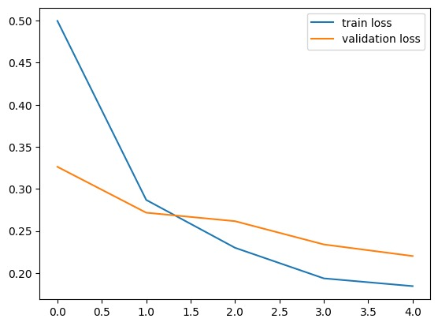
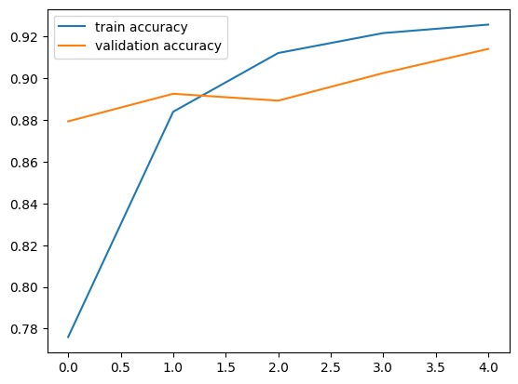
Results
The model achieved 94% training accuracy and 96% validation accuracy. It accurately predicts whether a person is wearing a mask or not. The results demonstrate a high success rate and reliability in differentiating between masked and unmasked faces.
Notes:
- Present the results of the face mask detection model

Slide 6
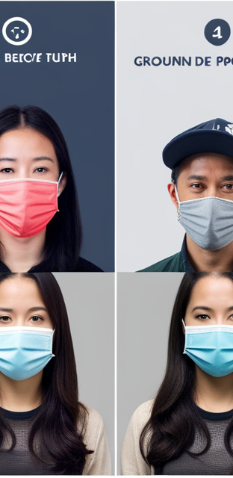
Analysis
The high accuracy obtained in face mask detection indicates good model performance. However, it is essential to consider false positives and false negatives in face mask detection. Factors such as dataset quality and diversity play a crucial role in model performance. Further optimization possibilities include refining the model architecture, tuning hyperparameters, and applying data augmentation techniques.
Notes:
- Analyze the results of the face mask detection model in terms of accuracy and potential errors

Slide 7


Conclusion
The CNN model for face mask detection showed promising results, with a high success rate and accuracy in identifying masked and unmasked faces. Further analysis using precision, recall, and F1-score is recommended to gain deeper insights into the model's performance. Face mask detection using CNNs has the potential to significantly contribute to public health and safety during the COVID-19 pandemic.
Notes:
- Summarize the key findings and results of the face mask detection model

Slide 8
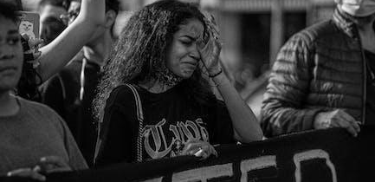

Contribution
All group members contributed equally to the project
Notes:
- Introduce the section on contribution

Slide 9

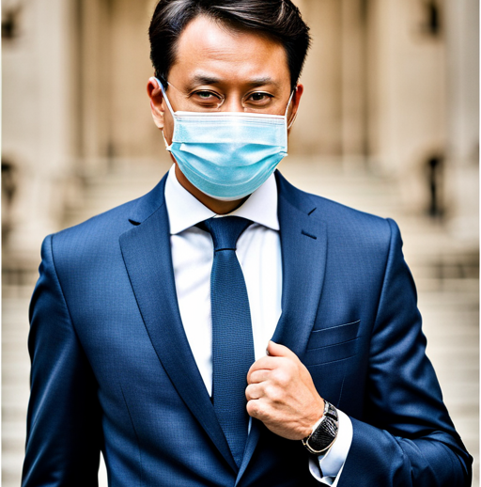
Conclusion
- The CNN model for face mask detection achieved high accuracy in identifying masked and unmasked faces
- Further analysis using precision, recall, and F1-score is recommended to gain deeper insights into the model's performance
- Face mask detection using CNNs significantly contributes to public health and safety during the COVID-19 pandemic
Notes:
- Summarize the key points from the presentation

Slide 10
Thanks!
Do you have any questions?

